Slide 1
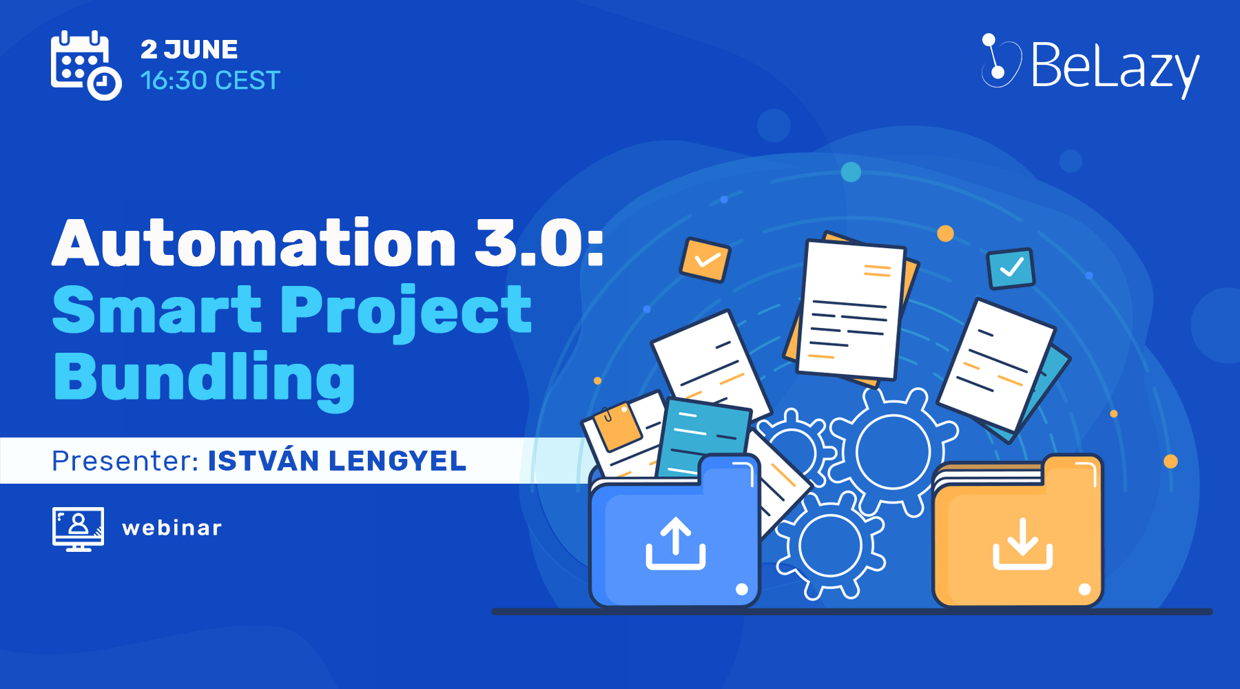

Slide 2
BeLazy is a cloud-based, secure – ISO 27001-certified – middleware (integration platform) that integrates various sources of work with systems that register and manage projects, automating sending and receiving projects:
Vendor portals
Translation management systems
INTO
Business management systems
Emails
Other recipient systems (vendor portal API)

Slide 3
What problems do we solve?
1
2
3
4
Customer sends multiple language pairs separately, not even at the same time - with or without the same files.
Customer sends different workflow steps in different tasks in their TMS (all online TMSes), or in their vendor portal (XTRF, Junction) – at the same time or at different times (e.g. LSO).
In the customer’s TMS, each file needs to be assigned separately to the vendor in each workflow step.
The project manager wants to put all the small projects for one end customer from one customer into the same monthly project – based on deadline or based on start date.

Slide 4
What What problems do we solve? #2
5
6
7
8
The customer sends tiny little projects, and we are losing on those by having to pay minimum fees to the vendors.
The customer sends a big project with many files, and a batch of words needs to be assigned to several freelancers.
You are the customer, and you want to send out updates only when they reach 2500 words, or every Tuesday.
I want to see the memoQ tasks coming from my customer’s server on a per-project basis.

Slide 5
What’s project bundling?
Human parity in machine PM
LocOps
PM automation
Virtualized PM

Slide 6
Why is this disruptive?
No-touch workflows exist in the industry, mostly at the largest LSPs.
BeLazy enables cost-effective automation for accounts with revenue under millions.
Automatic PM services are developed by consultants on a per case basis, with a limited lifespan.
Abstracting away each step of project management uncovers the decisions PMs implicitly make.

Slide 7
The implicit thinking process of a project setup
Monthly projects
LSO
Audio+subtitling job
Unit of PM overview
Project
Unit of work
Arbitrary\
Instructions missing
Different languages
Non-continuous updates
New microtransactions
Receivable? Client price line?
Unit for the client
Task
Several client tasks
Several files
Multilingual jobs in XTRF
One task (T+P) or more (TEP)
Job
Unit for the vendor
Unit of vendor assignment
Payable / vendor price line
One file
One package
One URL
Instructions
Unit for the vendor

Slide 8
The key to automation is explicitation
Receivable → Task
Avoid being implicit!
Payable → Job

Slide 9
How tools handle concepts differently?
 | XTRF classic | XTRF smart | Plunet | Protemos
Name of project | Project | Project | Order | Project
Name of task (container of workflow) | Task | Target language | Item | Job chaining
Task creation limits | None | One per target language | None | None
Name of job | Job | Job | Job | Job
Job creation limits | Can create several of the same step with cloning | One per step in workflow | Can create several of the same step with cloning | One per step in workflow
Payable | Payable, description | Payable, description | Pricing line name | Payable note
Files | Added to task | Added to task, all tasks have same files | Project level, organized by src/trg language later | Added to project, connected to workflow chain
URLs | Description | Description | Description | File alternative

Slide 10
Workflow mapping prerequisites
Workflow mapping is supported in:
In Plunet, enter the names of the workflow steps into the Workflow template description.
The workflow must be explicit, i.e. it must contain at least as many steps as the TMS/VP workflow.

Slide 11
Step configuration options
Configure for each step whether:
✔
You need a receivable (and which one).
✔
You need a payable for the vendor.
✔
You want to reassign the vendor in the TMS/VP.
✔
You want to deliver the files back to the relevant step.
✔
You want to close the step in the TMS/VP.

Slide 13
Bundling screenshot (comes later)

Slide 14
Automated project management =
Workflow mapping
+
Bundling rules
+
Project naming

Slide 15
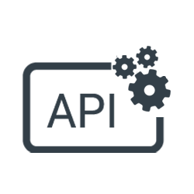
What’s the level of support?
Plunet, XTRF Classic – highest, full automation
XTRF Smart – limited in bundling due to its own limitation of no tasks
Protemos – no vendor assignment monitoring yet
LBS Suite – no full automation of workflows
APIs – no change in the next release. Focus of the release after: improvement of handling and mapping workflows in the API, URLs and instructions.

Slide 16
Where would YOU want to take BeLazy?

Slide 17
Thank you!

